Slide 1

Digital Payment Fraud Detection using Data Mining Techniques
Project — Data Warehousing & Data Mining (DWDM)
Course
Team
Data Warehousing & Data Mining (DWDM)
K Surya Teja – 23BCE8465 | C G Sindhu – 24BCD7162 | G L Narasimha – 23BCE8488
Faculty
Prof. Hari Seetha

Slide 2

BACKGROUND
Introduction & Motivation
The Digital Payment Landscape
Why This Matters
Rapid growth of UPI, online banking, and mobile wallets
Millions of transactions processed daily at scale
Rise in fraudulent activity driven by digitalization
Intelligent, automated detection systems are essential
Financial losses from fraud are significant and growing
Manual monitoring is inefficient and time-consuming
Fraud patterns are complex and constantly evolving
ML offers a scalable, data-driven solution
Problem: Traditional rule-based systems fail to identify complex fraud patterns in large-scale transaction data.

Slide 3
SCOPE
Project Objectives
1
2
Analyze Patterns
Apply Data Mining
Examine transaction data to identify distinguishing characteristics of fraudulent activity.
Use classification techniques from data mining to model fraud vs. legitimate transactions.
3
4
Implement Models
Compare Performance
Build multiple ML classifiers — Logistic Regression, Decision Tree, Random Forest, and KNN.
Evaluate and compare models using accuracy, precision, recall, and F1 score metrics.

Slide 4

DATA
Dataset Description & Preprocessing
Dataset Overview
Preprocessing Steps
Online payment transaction dataset where each row represents a single financial transaction.
Removed irrelevant attributes such as account IDs
Attribute
Description
Converted categorical variable type into numerical values
step
Time interval of transaction
type
Transaction type (e.g., TRANSFER)
Checked for and resolved missing values and duplicates
amount
Transaction value
Prepared clean dataset ready for ML model training
old/new balance
Origin & destination balances
isFraud
Target variable (0 or 1)
Dataset is highly imbalanced — fraudulent cases are a very small minority.

Slide 5
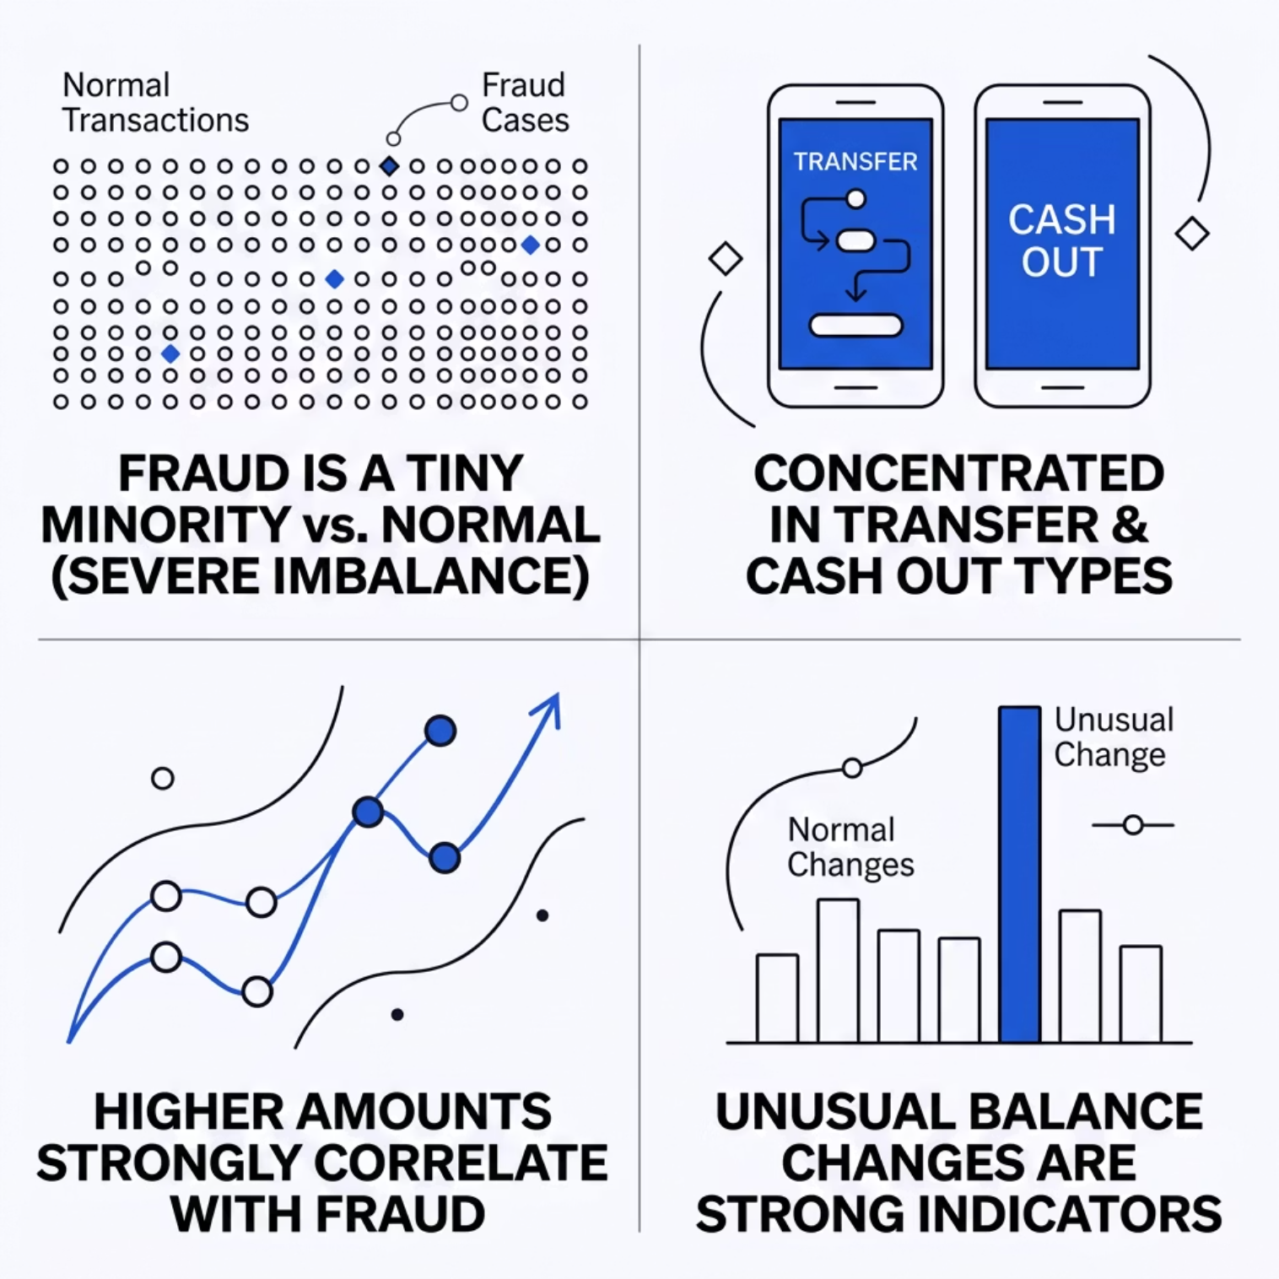

INSIGHTS
Data Visualization & Key Insights
What the Data Reveals
Fraud transactions are significantly fewer than normal — severe class imbalance
Fraud is concentrated in TRANSFER and CASH_OUT transaction types
Higher transaction amounts are more likely to be fraudulent
Unusual balance changes in origin/destination accounts are strong fraud indicators

Slide 6

METHODOLOGY
Models Used & Training Strategy
Logistic Regression
Decision Tree
Baseline linear classification model for binary fraud detection.
Interpretable rule-based model that splits data on key features.
Random Forest
K-Nearest Neighbors
Ensemble of decision trees improving accuracy and robustness.
Distance-based classifier grouping transactions by similarity.
Training Setup: 80:20 train-test split · Features and target separated · Data scaling applied for KNN · All models evaluated on held-out test data

Slide 7
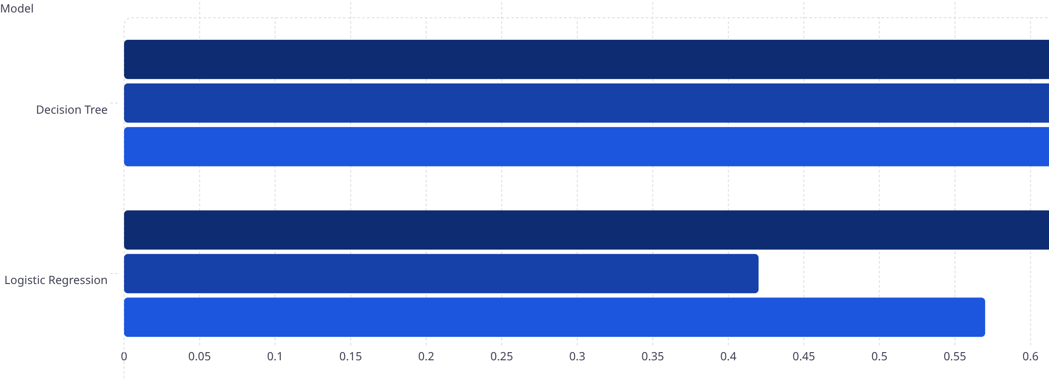
RESULTS
Model Evaluation Results
Precision
Recall
F1 Score
0.82
0.84
0.83
0.89
0.42
0.57
0.95
0.83
0.88
0.98
0.58
0.73
Accuracy (All Models)
99.99%
99.99%
Random Forest
KNN
99.96%
99.93%
Decision Tree
Logistic Regression

Slide 8
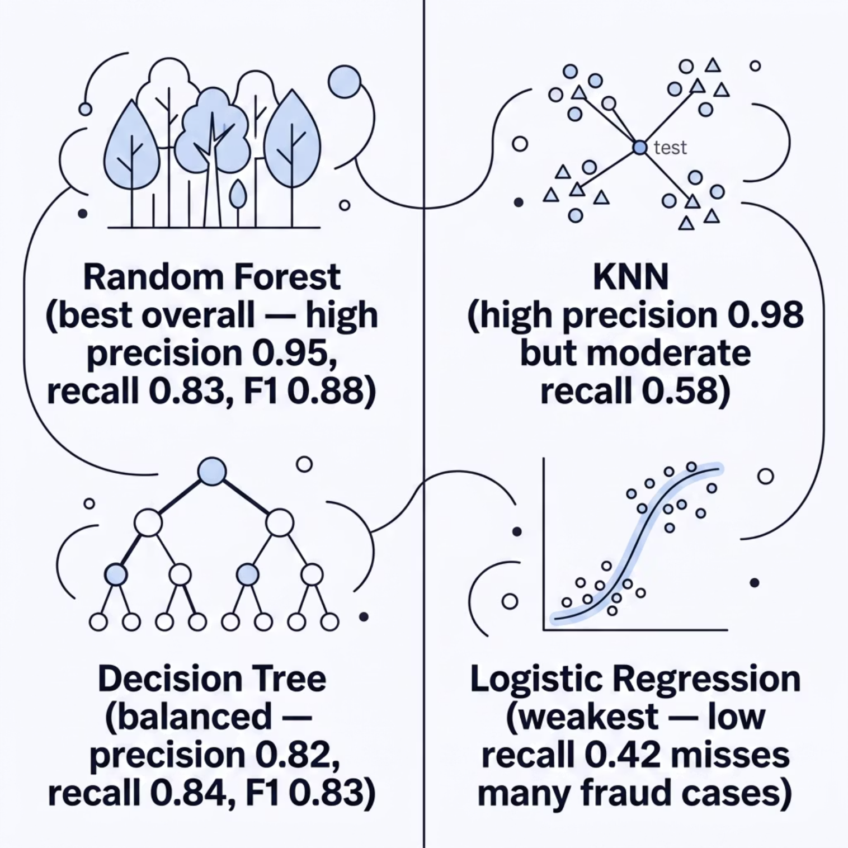
ANALYSIS
Model Comparison & Interpretation
Key Takeaways
Random Forest delivers the best overall performance with highest F1 score (0.88)
Decision Tree provides the most balanced precision-recall trade-off
Logistic Regression has critically low recall — misses many actual fraud cases
KNN is highly precise but misses ~42% of fraudulent transactions
Near-perfect accuracy is partly due to class imbalance in the dataset

Slide 9
LIMITATIONS
Challenges in Fraud Detection
Severe Class Imbalance
Accuracy is Misleading
Fraudulent transactions represent a tiny fraction of the dataset, making it hard for models to learn fraud patterns effectively.
High accuracy alone is insufficient — a model predicting "no fraud" always would still score ~99%. Recall and F1 are more meaningful metrics.
Missed Detections
Recall is Critical
Some fraudulent transactions remain undetected, particularly in models with low recall like Logistic Regression and KNN.
In fraud detection, missing a fraud case (false negative) is far more costly than a false alarm — recall must be prioritized.

Slide 10
SUMMARY
Conclusion
Data Mining is Effective
Project Summary
Classification techniques successfully identify fraudulent transactions from large-scale payment data.
This project demonstrates that data mining techniques — especially ensemble methods — provide reliable, scalable fraud detection for digital payment systems.
Multi-Model Approach Wins
Comparing multiple models provides deeper insight — Random Forest emerged as the top performer.
THANK YOU
Imbalance Remains a Challenge
Class imbalance limits detection capability; techniques like SMOTE could improve future results.
Future Scope
Deep learning models and real-time detection pipelines can further enhance fraud detection accuracy.
Under the guidance of Prof. Hari Seetha
Course: DWDM

